Slide 1
Variables and Simple Data Types

Slide 2
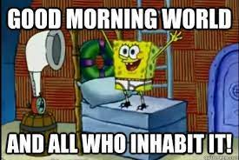
The Simple Program… HELLO WORLD!

Slide 3
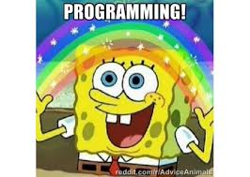
Congrats! You are now a programmer.

Slide 4
Learning Objectives
Explain what a variable is and why they’re used
Be able to identify a number of variable types
Select the appropriate variable type for a given scenario
Store and recall data using a variable

Slide 5
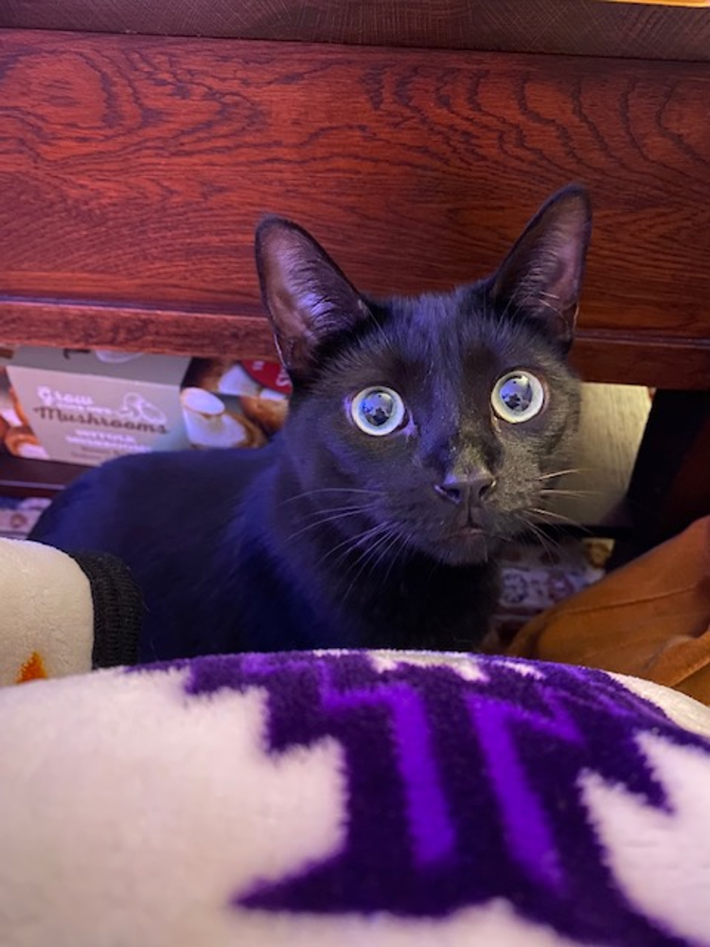
I have a cat, named Noche

Slide 6
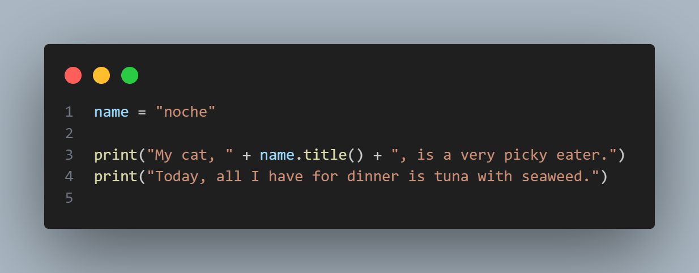
Take a look at this… What would happen if I ran it?
Notes:
name = "noche"
print("My cat, " + name.title() + ", is a very picky eater.")
print("Today, all I have for dinner is tuna with seaweed.")

Slide 7
Variables
Variables are just containers that hold a value that you can use later on in your program. You will frequently use variables in programming to store many different things!
Notes:
Variables are just containers that hold a value that you can use later on in your program. You will frequently use variables in programming to store many different things!

Slide 8
Notes:
name = "noche"
print("My cat, " + name.title() + ", is a very picky eater.")
print("Today, all I have for dinner is tuna with seaweed.")
Show variables here then give an example:
cat = "Noche"
print(cat)

Slide 9
But There Are Some Rules When Using Variables…
Variable names can contain only letters, numbers, and underscores. They can start with a letter or an underscore, but not with a number.
Spaces are not allowed in variable names, but underscores can be used to separate words in variable names.
Avoid using Python keywords and function names as variable names; that is, do not use words that Python has reserved for a particular programmatic purpose, such as the word print.
Variable names should be short but descriptive.
Be careful when using the lowercase letter l and the uppercase letter O because they could be confused with the numbers 1 and 0

Slide 10
One More Thing to Look Out For… ERRORS
Here is a list of some common errors:
A traceback is a record of where the interpreter ran into trouble when trying to execute your code.
TypeError: When you try and do an operation on a data type that is not the correct operation for that data type.
Syntax Error: Something has gone wrong with your Python Syntax!
Errors are very useful!

Slide 11
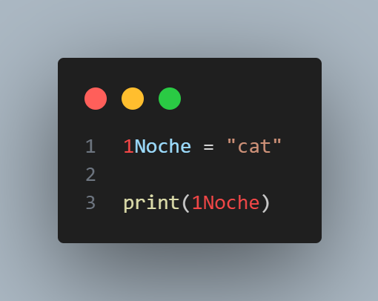
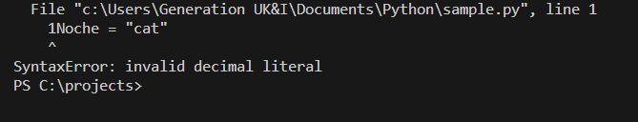
Variable names can contain only letters, numbers, and underscores. They can start with a letter or an underscore, but not with a number.

Slide 12
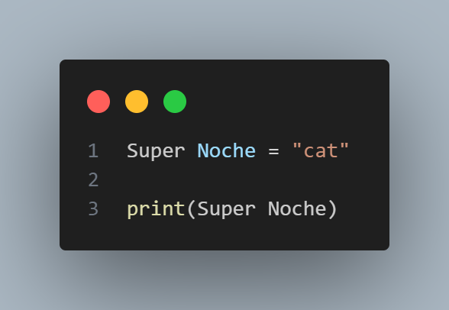

2. Spaces are not allowed in variable names, but underscores can be used to separate words in variable names.

Slide 13
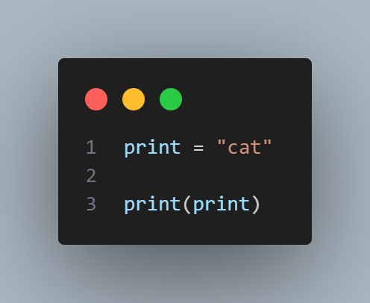

3. Avoid using Python keywords and function names as variable names; that is, do not use words that Python has reserved for a particular programmatic purpose, such as the word print.

Slide 14
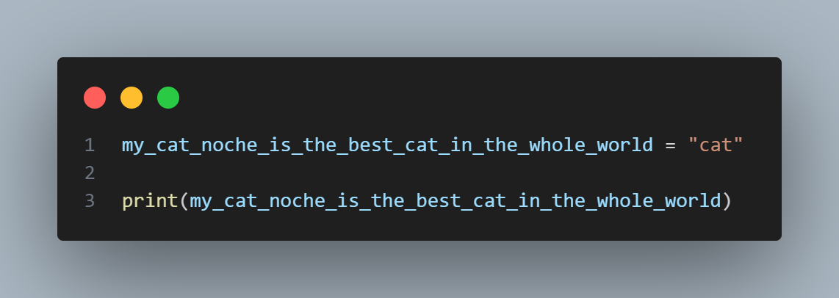
4. Variable names should be short but descriptive.

Slide 15
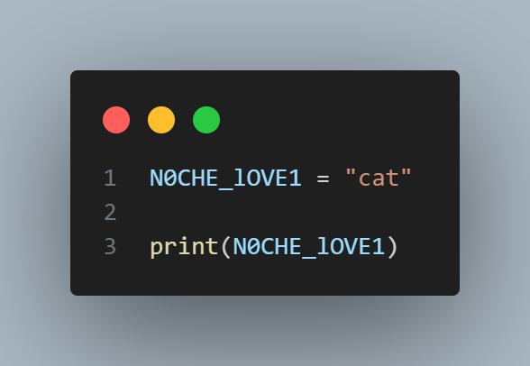
5. Be careful when using the lowercase letter l and the uppercase letter O because they could be confused with the numbers 1 and 0

Slide 16
Strings
A string is simply a series of characters inside quotes
Python recognises single or double quotes to declare your strings
When you need to use apostrophes or quotation marks in your string, use the opposite symbol to declare it
Useful when you have numbers that should not be treated mathematically e.g. phone number, house number. You will never need to take a phone number and divide it by 2 for example.
You can manipulate the formatting and value of a variable with methods

Slide 17
Notes:
name = "noche"
print("My cat, " + name.title() + ", is a very picky eater.")
print("Today, all I have for dinner is tuna with seaweed.")
Identify strings here, then give simple example:
print("Hello Noche! How are you feeling today?")

Slide 18
Changing the Case in a String
.title() - Capitalises first characters of words
.upper() - uppercase all characters
.lower() - lowercases all characters
There are many different methods that can be used to modify your strings, review some of them here.

Slide 19
Notes:
name = "noche"
print("My cat, " + name.title() + ", is a very picky eater.")
print("Today, all I have for dinner is tuna with seaweed.")
Identify use of case here.

Slide 20
Concatenating Strings
Python uses the plus symbol (+) to combine strings.
In programming, whitespace refers to any nonprinting character, such as spaces, tabs, and end-of-line symbols.
You typically plan for whitespace to organize your output so it’s easier for users to read.
Addition formatting can be applied to your strings using escape characters:
You can add tabs to your strings using: \t
You can print on a new line using: \n
When Python encounters the backslash in your string it recognises the next character is an instruction, not part of the string
See some additional escape characters here: https://www.w3schools.com/python/gloss_python_escape_characters.asp

Slide 21
Notes:
name = "noche"
print("My cat, " + name.title() + ", is a very picky eater.")
print("Today, all I have for dinner is tuna with seaweed.")
Show another example of combining strings as well as use for /n and /t using:
cat = "noche"
print("I have a cat named " + cat.title() + " he loves to sleep and have his belly rubbed." )

Slide 22
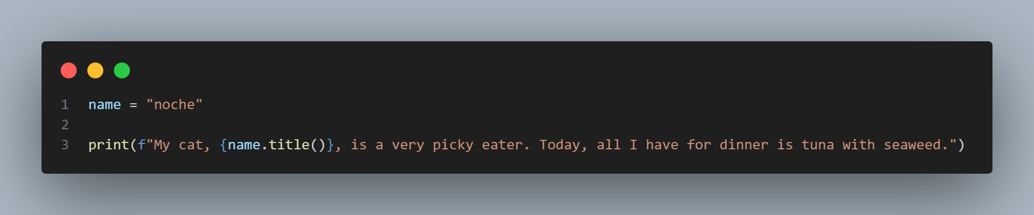
Another way to combine strings and variables - f-strings!
Notes:
name = "noche"
print(f"My cat, {name.title()}, is a very picky eater. Today, all I have for dinner is tuna with seaweed.")

Slide 23
Stripping Whitespace
It’s important to think about whitespace
Many typists have a habit of automatically pressing space after each word
Often you’ll want to compare two strings to determine whether they are the same, for example:
Checking people’s usernames when they log in to a website.
Confirming a choice against available options
Python can look for extra whitespace on the right and left sides of a string.
Remove whitespace from the left or right end of a string using the lstrip() or rstrip() methods.
Strip whitespace from both sides at once using strip()
Notes:
cats = " weasley "
print(f"I played with {cats.title().strip()} all night long and he is still not tired!")

Slide 24
Adding Comments
Using # to add comments to help you write notes in your program.

Slide 25
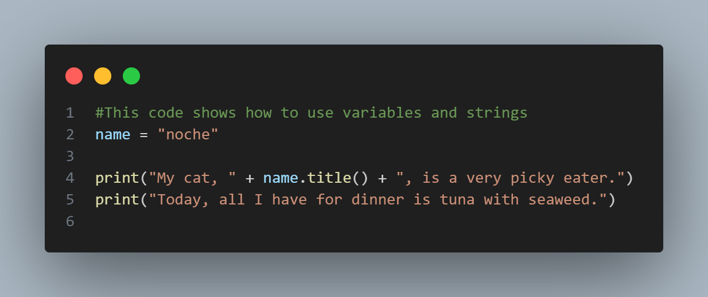
Notes:
#This code shows how to use variables and strings
name = "noche"
print("My cat, " + name.title() + ", is a very picky eater.")
print("Today, all I have for dinner is tuna with seaweed.")

Slide 26
Now that you know it all…..

Slide 27
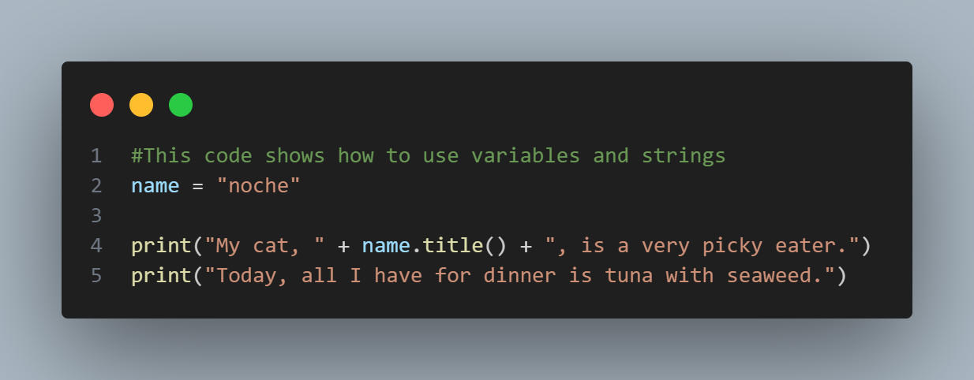
Try Modifying this Code to Make it Your Own! When you are done, post your code into your chat channel!
Notes:
#This code shows how to use variables and strings
name = "noche"
print("My cat, " + name.title() + ", is a very picky eater.")
print("Today, all I have for dinner is tuna with seaweed.")

Slide 28
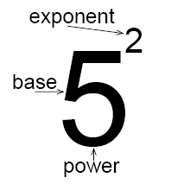
Numbers
You can add (+), subtract (-), multiply (*), and divide (/) integers in Python.
Python uses two multiplication symbols (**) to represent exponents (raised to the power of…)
In a terminal session, Python simply returns the result of the operation.
When writing numbers with multiple zeros, you can add underscores to make it more legible!
E.g. 1000000000 = 1_000_000_000

Slide 29
Integers
Floats
Python calls any whole, positive or negative number, an integer.
Python calls any number with a decimal point a float.
When using integers declared as floats, keep in mind that Python will always automatically display the answer as a float, even when the answer is actually a whole number.

Slide 30
Avoiding Type Errors with the str() Function
A type error means Python can’t recognize or utilise the type of data you’re providing. For example
Providing a str() for an integer (mathematical) operation
Providing a number for a string method
str() will tell Python to represent non-string values as strings.
Notes:
TYPE ERROR-
age = 23
message = "Happy " + age + "rd Birthday!"
print(message)
RIGHT -
age = 23
message = "Happy " + str(age) + "rd Birthday!"
print(message)
ANOTHER EXAMPLE -
RIGHT -
equation = "1 + 2 = "
answer = 1 + 6
print(equation + str(answer))
OR
equation = "1 + 2 = " + str(1 + 2)
print(equation)

Slide 31
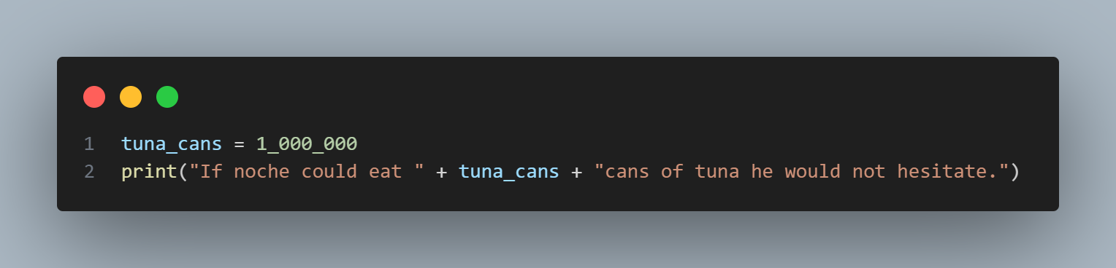
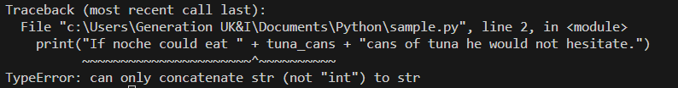
Without str()
Notes:
#This will give an error
tuna_cans = 1_000_000
print("If noche could eat " + tuna_cans + "cans of tuna he would not hesitate.")

Slide 32
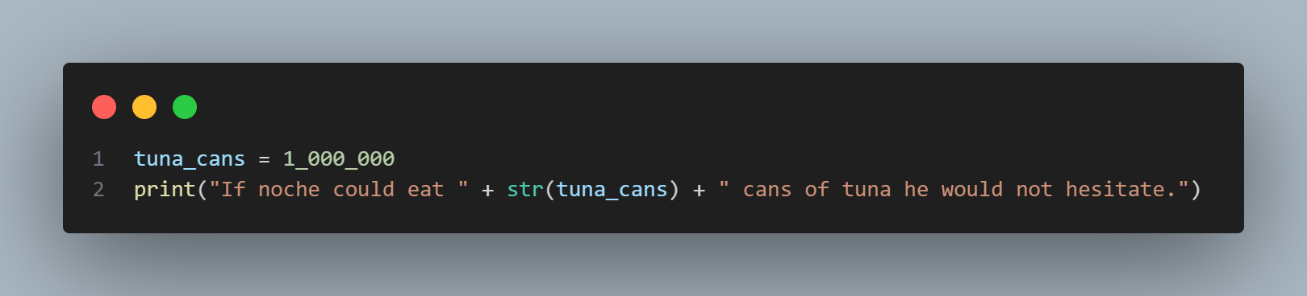
With str()
Notes:
#This will not give an error
tuna_cans = 1_000_000
print("If noche could eat " + str(tuna_cans) + " cans of tuna he would not hesitate.")

Slide 33
Let’s do some exercises to practice what we’ve learned! Complete exercise 1: Variables, Strings, and Data Types

